Slide 1
Foreign trade activity of the enterprises from SME sector,

Slide 2
Foreign trade activity of enterprises in the Small and Medium-sized Enterprise (SME) sector refers to the import and export activities conducted by these businesses with partners and customers located in foreign countries. SMEs play a vital role in international trade as they contribute significantly to the economy and overall trade volume of a country. Foreign trade activity of enterprises in the Small & Medium-sized Enterprise (SME) sector may also create employment & may also vary greatly depending on many several factors for instance the country where the business is being conducted in & operate, nature of the industry & business.
Here are some key points regarding foreign trade activity of SMEs:

Slide 3
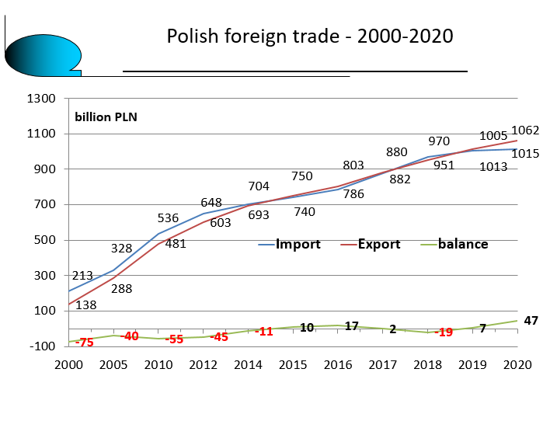
Imports: SMEs also import goods and services from foreign suppliers to meet domestic demand or for further processing and manufacturing. Importing enables SMEs to access raw materials, components, machinery, and or finished products to meet domestic demands or enhance their offerings. Importing also enables SME’s to access a wider range & variety of specialized products not available or cost-effective locally. The importance of Small & Medium-Sized enterprises is best illustrated on the diagram below in the Polish foreign trade as it helps bring balance between the imports & exports.

Slide 4
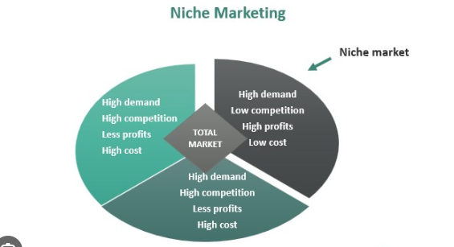
Exports: SMEs engage in exporting goods and services to customers in foreign markets. They identify potential markets, establish distribution channels, and comply with trade regulations and documentation requirements. SMEs may also identify niche markets:

Slide 5
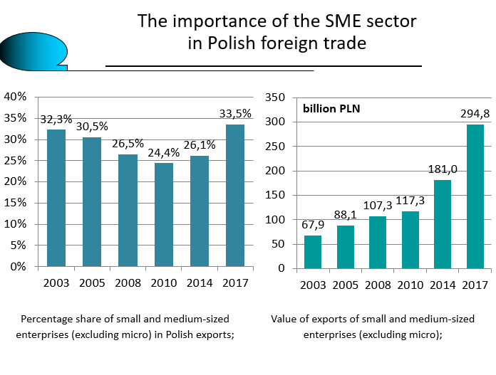
Foreign trade through exports allows SMEs to expand their customer base, increase sales, diversify & increase their revenue streams. Governments in other countries have started export support initiatives for SMEs for instance the Polish government which gives opportunities & assistance on learning how to export, the preparation of products for export, searching for foreign partners at exhibitions & economic missions, insurance of contracts & payment receivables, securing payment transactions by Polish banks based on such payment methods as: Documentary letter of credit & Documentary collection. Foreign trade through exports allows SMEs to expand as best shown in the diagram:

Slide 6
Government Support: Many governments provide support programs, grants, and incentives to encourage SMEs' involvement in foreign trade. These initiatives aim to enhance SMEs' competitiveness, provide export training, offer financial assistance, and reduce barriers to entry in foreign markets. There are government initiatives which support exports such as KUKE (support all).It was established in the early 1990’s & the shareholders are the State Treasury & Bank Gospodarki Krajowej.In the 25 years operation KUKE has developed its operations in 6 continents in relation to 106 countries around the world & has insured transactions for PLN 330 billion, also the corporation offers insurance of medium & long term exports contracts guaranteed by the State Treasury, external financing & contractual guarantees.

Slide 7
Trade Fairs and Exhibitions: SMEs often participate in international trade fairs, exhibitions, and business conferences to promote their products or services to potential foreign buyers. These events serve as platforms for networking, establishing business contacts, and exploring new market opportunities.

Slide 8
Joint Ventures and Partnerships: SMEs may form joint ventures or partnerships with foreign companies to gain access to international markets. These collaborations can provide SMEs with valuable market knowledge, distribution networks, and local expertise, helping them navigate foreign business environments more effectively.

Slide 9
E-commerce and Online Marketplaces: The rise of e-commerce platforms and online marketplaces has significantly facilitated international trade for SMEs. These platforms offer SMEs the opportunity to showcase their products to a global audience and engage in cross-border transactions without the need for a physical presence in foreign markets. Also E-commerce in relation to INCOTERMS under the International Chamber Of Commerce which was first published in 1936 a set of rules for general use by traders was set. SMEs through INCOTERMS can help them improve in commercial trade as set of rules are not obligatory but are usance hence the Buyer & Seller may agree on their terms to improve businn

Slide 10
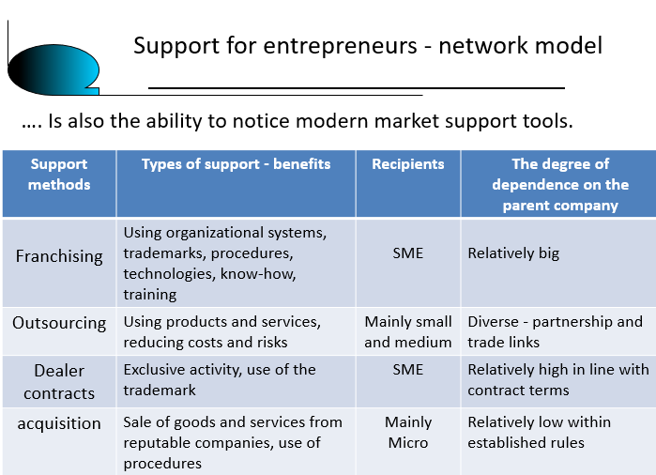
Licensing and Franchising: Some SMEs engage in licensing or franchising arrangements, where they grant the rights to foreign entities to use their intellectual property, brand, or business model. This approach allows SMEs to expand into international markets without establishing physical operations overseas. Licensing and franchising can be a strategy to generate revenue from foreign markets and increase brand visibility.

Slide 11
SMEs play a significant role in job creation through their engagement in foreign trade activities. Here are some ways in which SMEs contribute to employment through foreign trade: Direct Employment: SMEs that engage in foreign trade often need to expand their workforce to handle increased production, export/import operations, customer support, logistics, and other related activities. As SMEs expand their international reach and increase their trade volume, they create direct employment opportunities, hiring more workers to support their operations. Indirect Employment: SMEs involved in foreign trade often rely on a network of suppliers, service providers, and distributors to support their international operations. This creates indirect employment opportunities in the supply chain. For example, SMEs exporting goods may require raw materials or components sourced from local suppliers, leading to additional jobs in the upstream industries. Supporting Industries: Foreign trade activities of SMEs can stimulate employment in supporting industries such as transportation, logistics, packaging, and finance. These industries provide essential services required for exporting or importing goods. SMEs that engage in foreign trade often rely on these industries to facilitate their international transactions, leading to job creation in these sector’s. The next slide will show the importance of SMEs & how they play a role in job creation through a diagram.

Slide 12
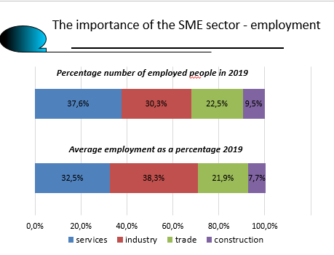

Slide 13
SME’s may also create employment by supporting Industries: Foreign trade activities of SMEs can stimulate employment in supporting industries such as transportation, logistics, packaging, and finance. These industries provide essential services required for exporting or importing goods. SMEs that engage in foreign trade often rely on these industries to facilitate their international transactions, leading to job creation in these sectors. Market expansion & growth: Engaging in foreign trade allows SMES to access larger markets beyond their boundaries. By tapping into international markets, SMEs can increase their sales & revenue. As a result, SMEs that experience growth through foreign trade are more likely to expand their operations & hire additional employees to meet the increased demand for their products or services. The diagram in the next slide illustrates how SMEs are important in job creation between 2009 to 2019.In 2009, 8.8 million people worked in the enterprise sector whilst in 2019, 10 million people worked in the enterprise sector, including 6.8 million SMEs.

Slide 14
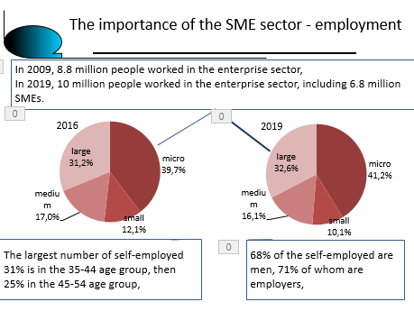

Slide 15
It’s important to note that the foreign trade activity of SMEs can be influenced by factors such as trade policies, economic conditions , currency fluctuations, regulatory frameworks & geopolitical considerations hence, the specific foreign trade strategies & activities of SMEs can vary significantly across different industries & countries.

